Slide 1
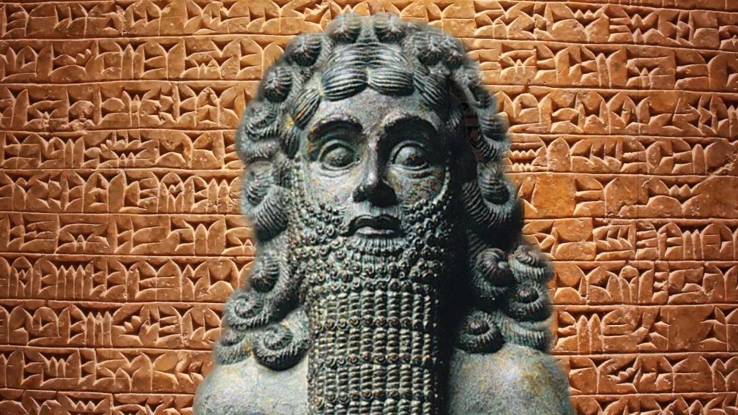

Slide 2
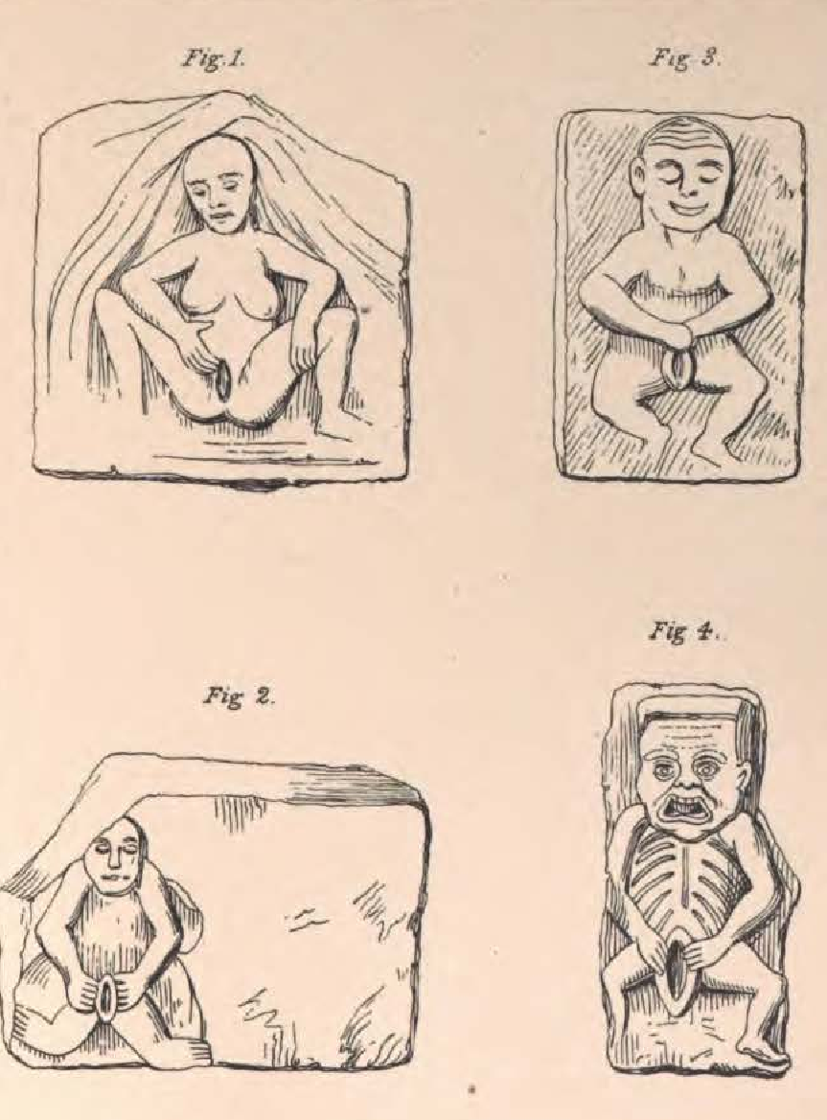
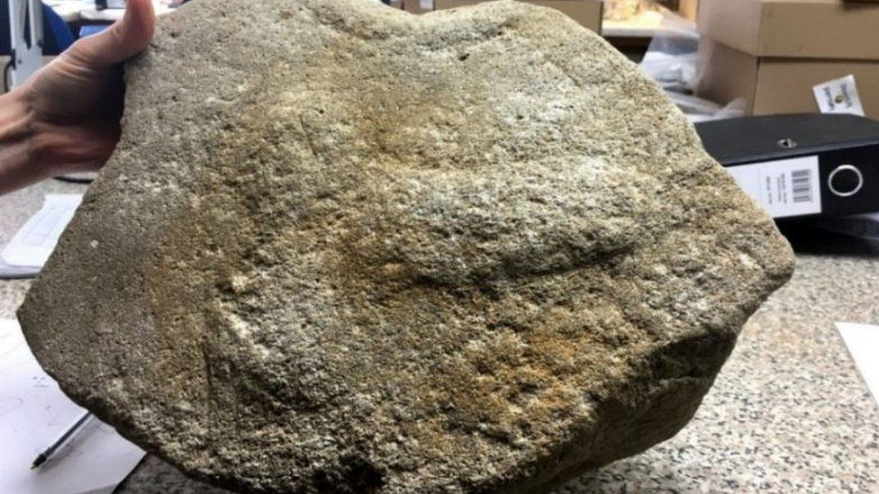
Churches were decorated with primitive versions of the Ark and the cross.

Slide 3
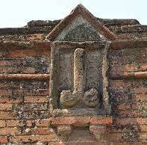
The Ark of the Covenant
The Ark
The Rod of Aaron
Two Stone Tablets
Three-in-one God
Notes:
as all oaths were sworn on the phallus, as when Abraham swore his servant (Gen. XXIV, 9), as eastern men do to this day, or when we swear on the cross, which is the complete male organ, Rod of God, and two stones of Moses's Ark. But without the “stones” no creation of life could be made, so Moses put the Rod of God and two stones in the Ark (woman), to form the “Three - in - one' God, creator of all life. Male in female

Slide 4
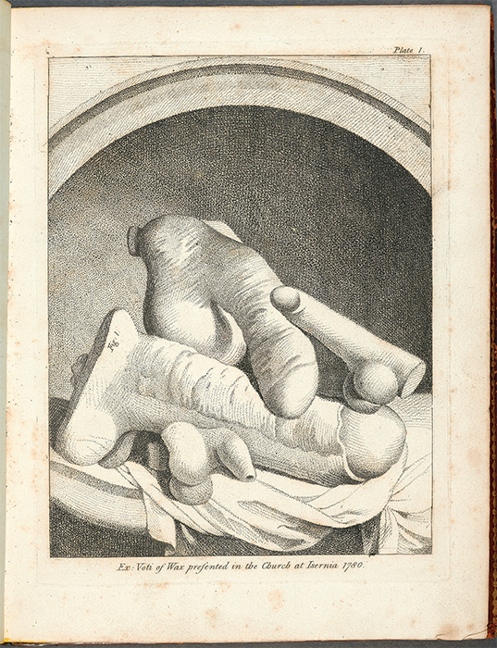
A cache of 4000 buried phalluses found in Rome

Slide 5
Cloistered nuns have less syphilis.
“Water atop a hill” is a brothel (the first church).
Originally Jack and Gill.
Syphilis
Notes:
the rhyme was first known as Jack and Gill

Slide 6
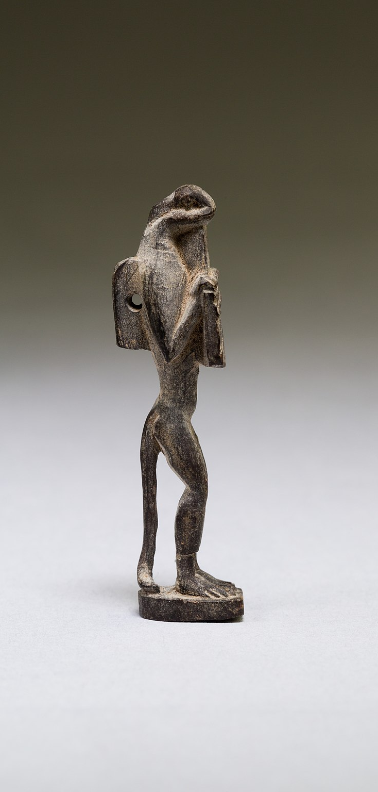
Pharaoh
Phalaoh
Phalla+Oh
Phallus
Ka Kau
Phallus, son of the Phallus.
Notes:
Egyptian has only one sign for R and L , and unfortunately the first readers of the hieroglyphics chose the wrong letter , as the kingly title of Egypt is one of these double - sex names , from the male Pala of India coupled with the female ring or oval 0 ; so the name should be Phala - O , or Phala - Oh , not Phara - oh , as we write it , and certainly not Fair - oh , as we pronounce it . The native ear is quite retentive , and the native speaks of the nude , working Egyptian as a Phala or Phellah , the terminal “ a ” or “ ah ” being in this case the female symbol , as frequently used as the O. Some speak of the Egyptian fellah , our word fellow , or plural fellahim , or fellahin , “ m ” and " n ” being used indifferently ( the eastern plural , as in the Hebrew Bible ; " Eloh , " god , " Elohim , gods , plural ) . So the “ Fairo , ” as we call the Egyptian ruler , should be Pala - o or Phala - o , not Phara - oh , and it is so written on the monu ments . In Greece “ pala ” became “ phallos , ” and in Latin “ phallus , " from which we derive the adjective " phallic , ” used to describe all literature.

Slide 7
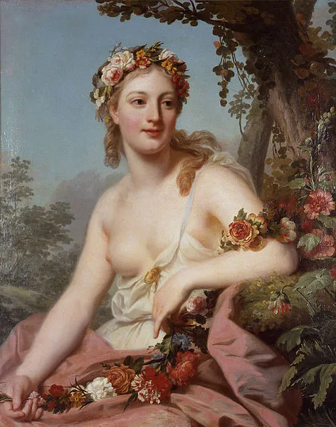
Monthly Anti-Modesty fête days — when "all bonds were loosed" and a huge model of the male organ , the Hindoo pala , or phallus, ” in Latin , was carried in a procession , which finally degenerated into extreme licentiousness — the people indulging in the most infamous vices in full daylight.
Liberalia
Floralia
Lupercalia
Vulcanalia
Fornicalia
Bacchanalia
Dionysiaca Maternalia
Hilaria
Priapeia
Bona Dea
Adonai
At the celebration of Floralia, Cato, not at all dis approving of the licentious exhibitions, retired, so that his well - known gravity or modesty might in no wise restrain the celebrants, because the multitude showed hesitation in stripping the “nuns” or sacred prostitutes stark - naked in presence of a man so celebrated for his modesty.

Slide 8
Notes:
The Persians had their legend that Yima , the Creator - on - Earth , was given a “ piercer , " or dagger , and a " ring ” with which to create all life . These , of course , represented the male and female organs , and their conjunction or marriage is symbolised to - day by passing the finger of the person being married ( that is of the woman , and “ married ” is French

Slide 9
Swearing on the phallus

Slide 10
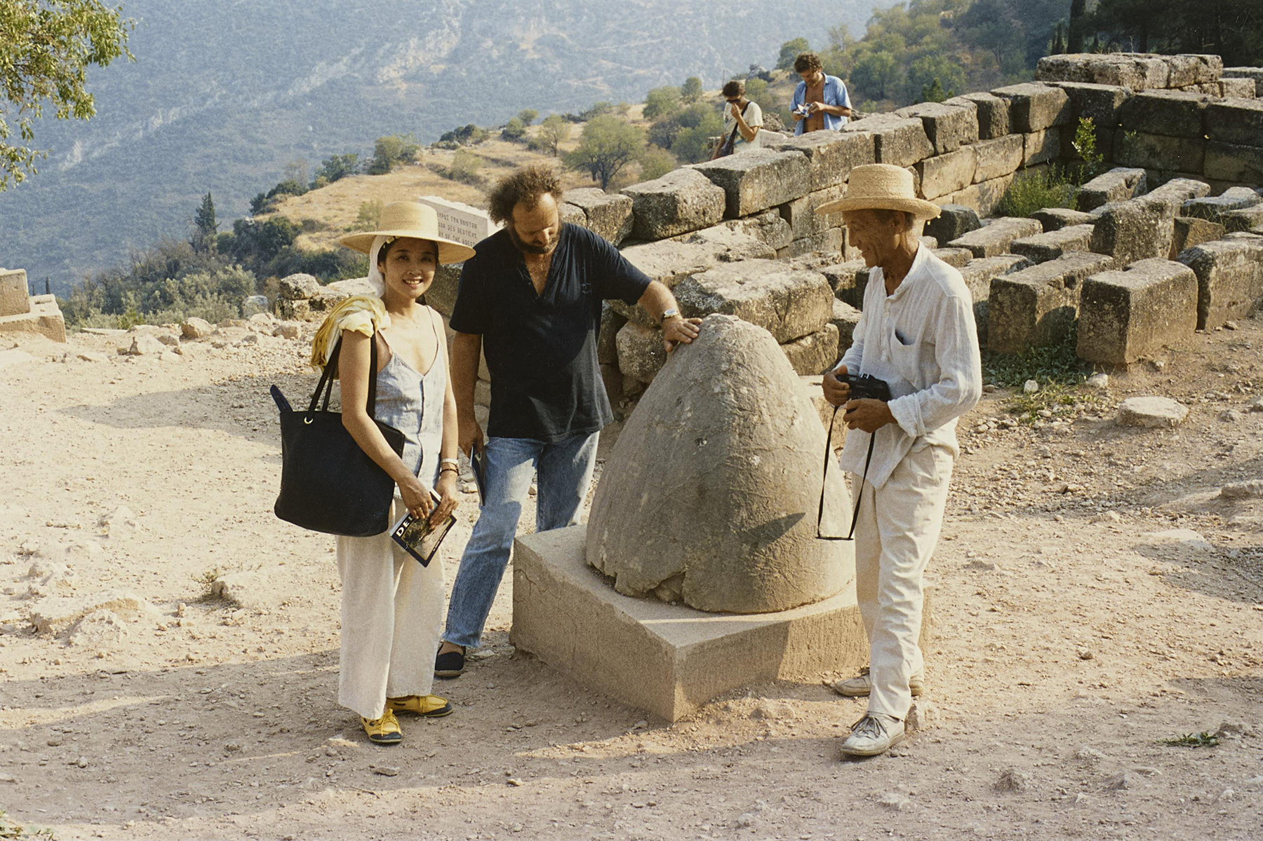
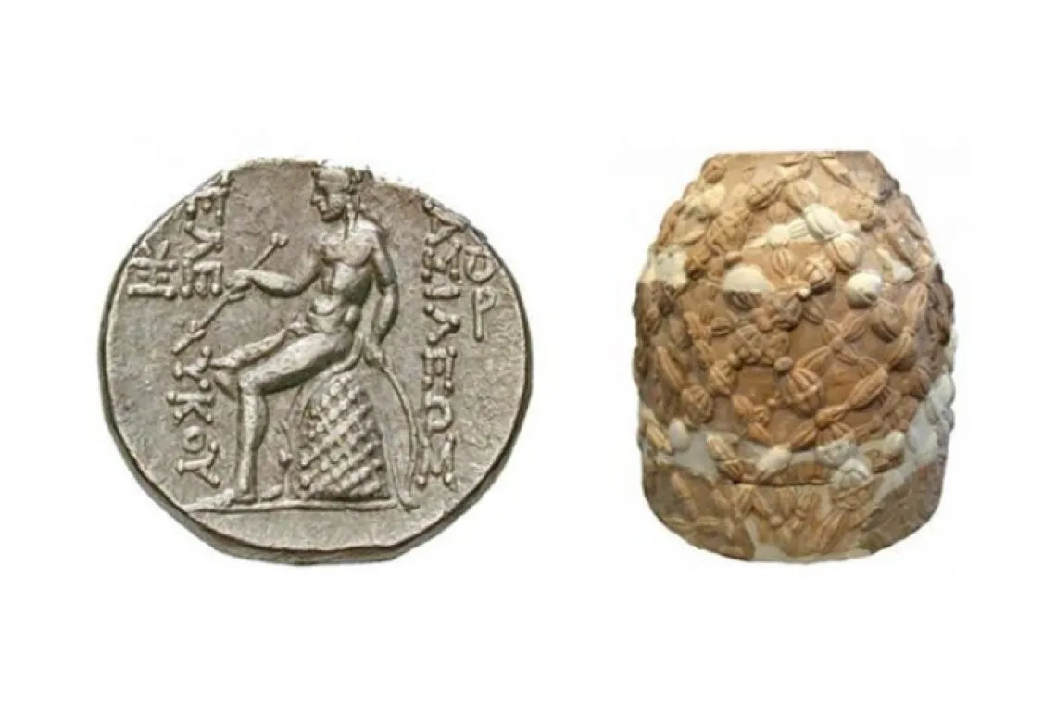
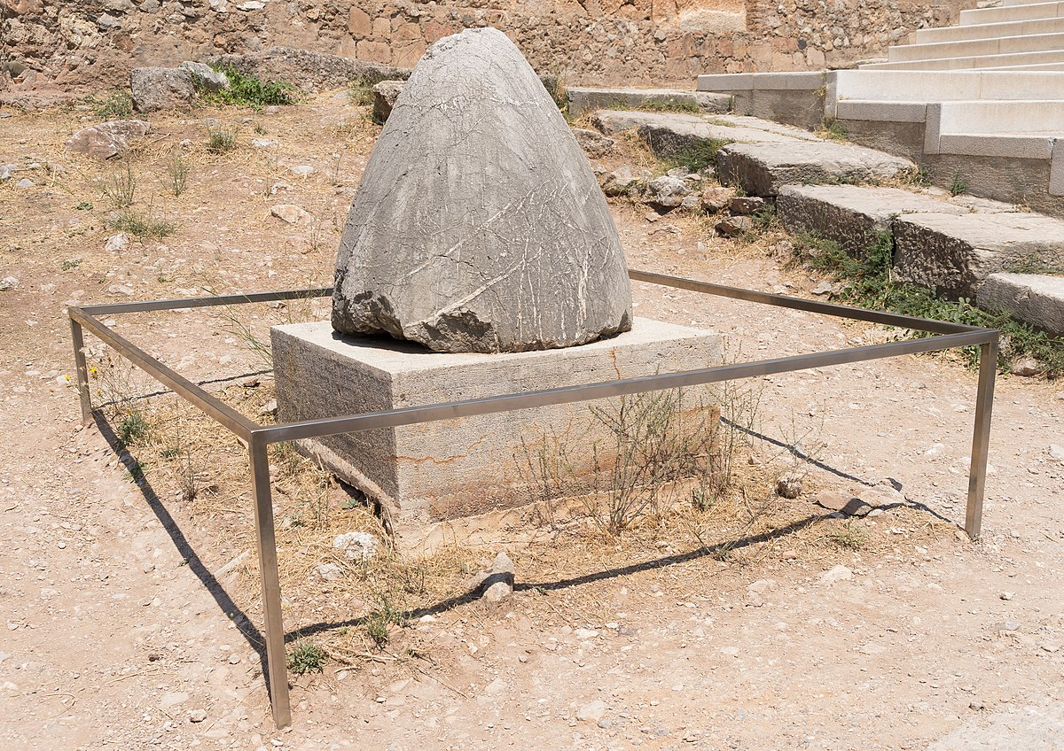
Omphalos doesn’t mean navel.

Slide 11
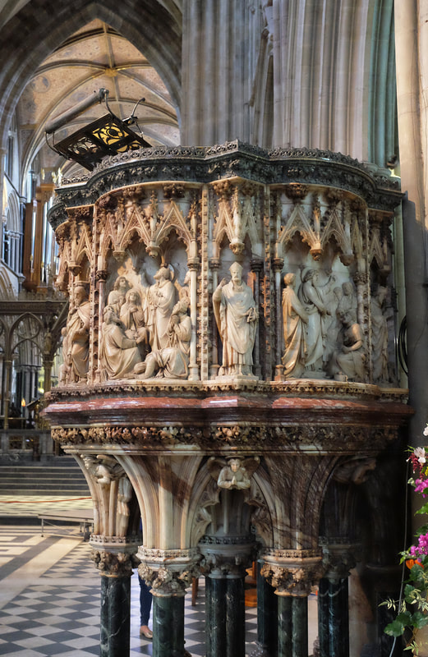
Pulpit is the male and female sex organs combined.
India - Christ + Na
Rome - Christ + Os

Slide 12
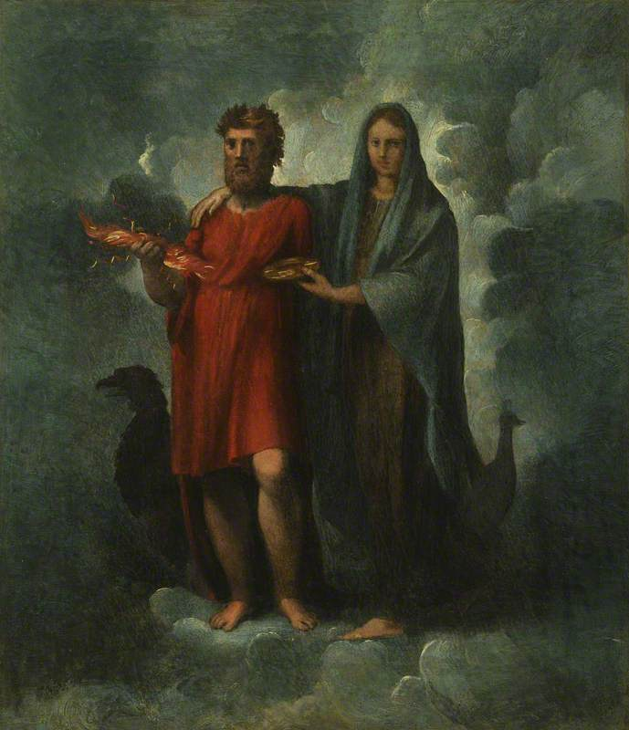
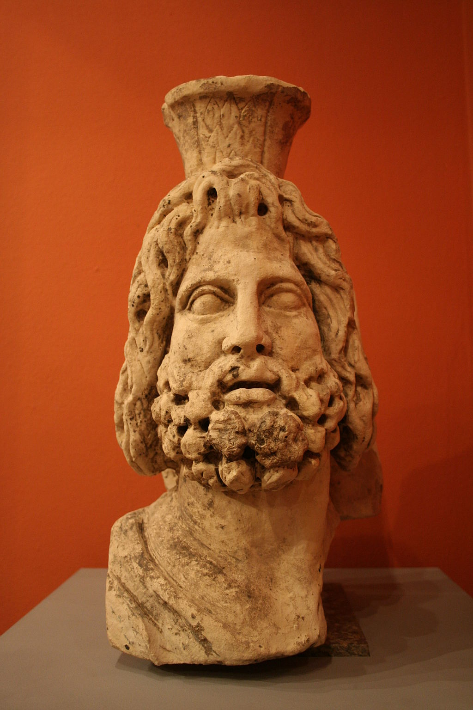
The name Iesu, our Jesus, is a curious combination of Roman and Indian symbolism. The IU are, of course, frankly Roman, as in their “IUpiter " or "IUno,” our Jupiter and Juno. But the "es" has a very different origin. The great god of India had a long titular name, and was double-sexed, like IHOH and Ies U.
IesU
IUpiter
IUno

Slide 13
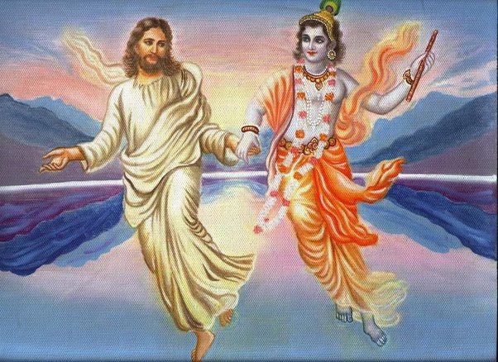
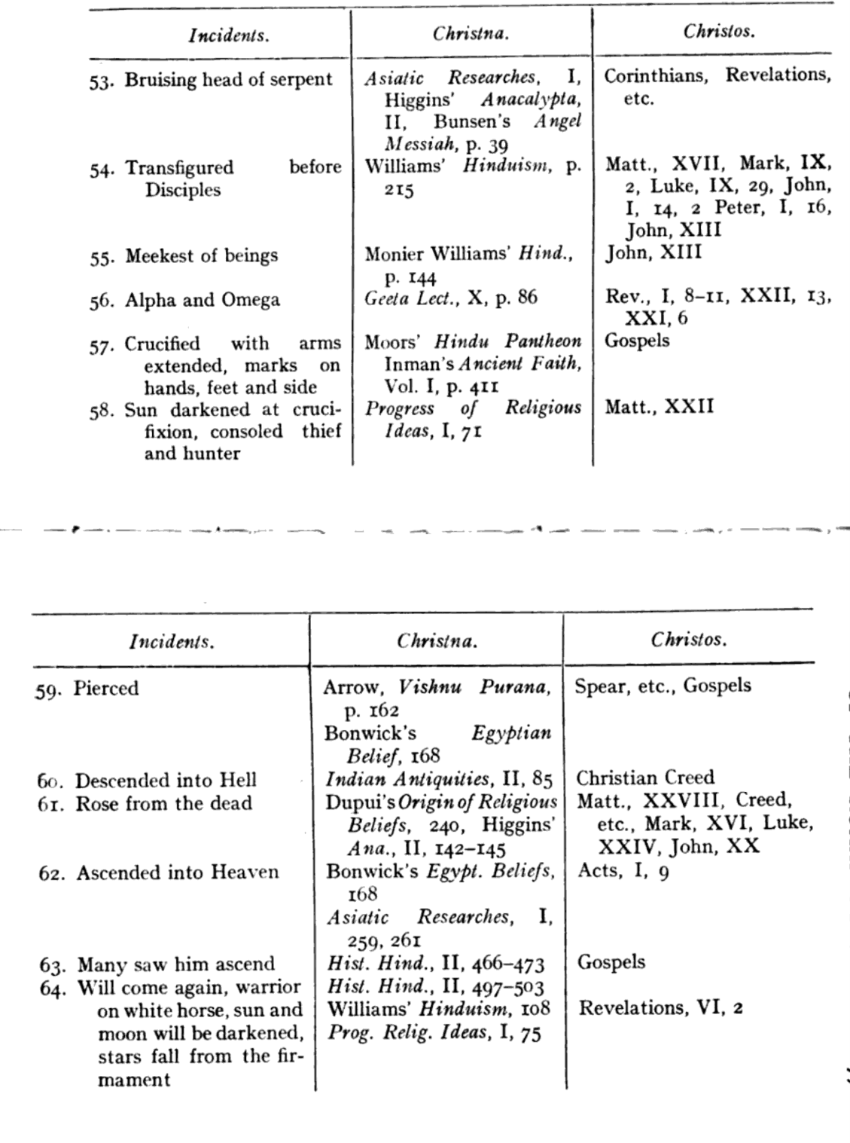
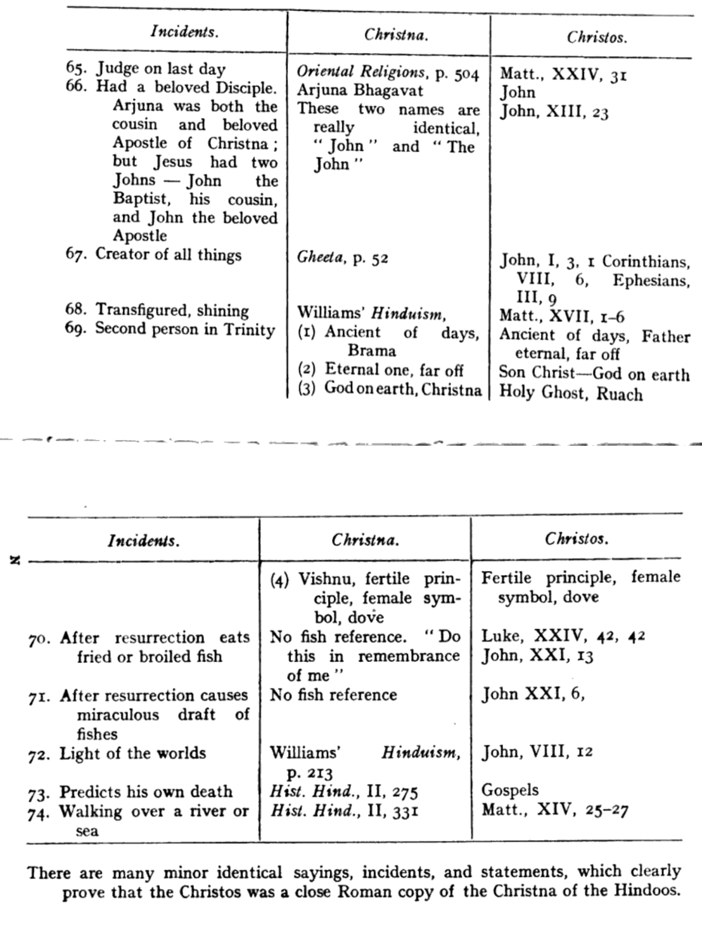
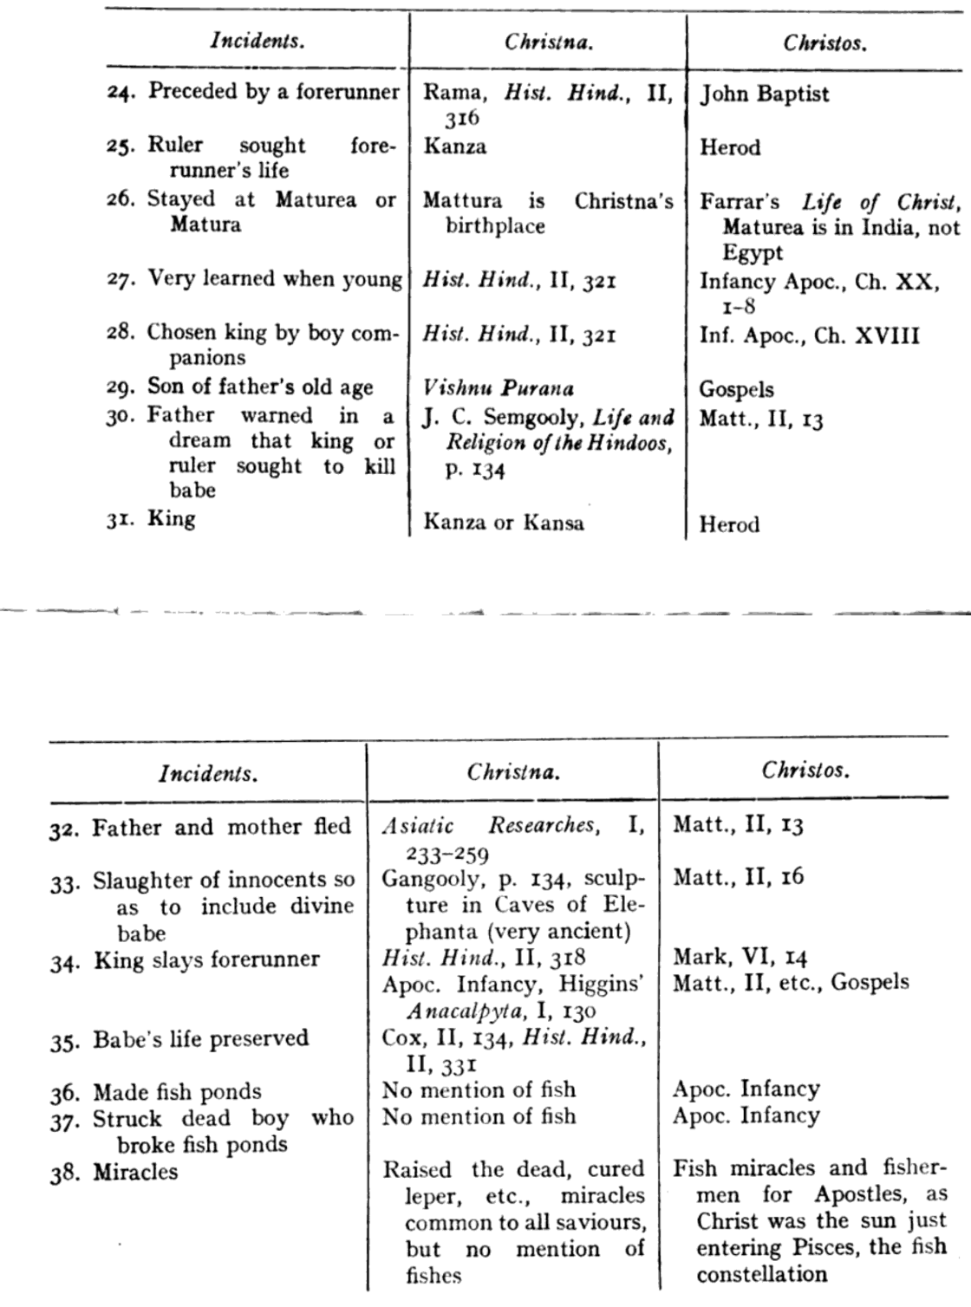
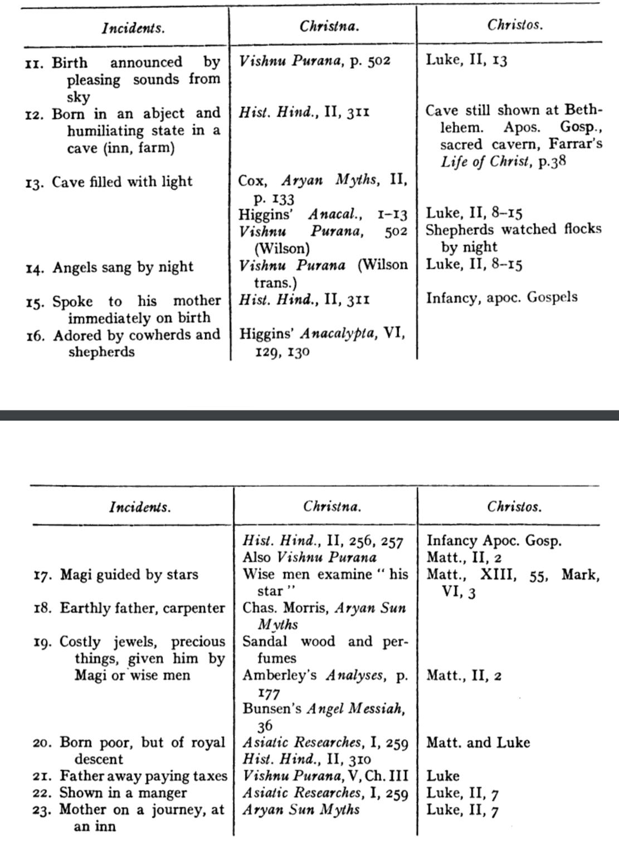
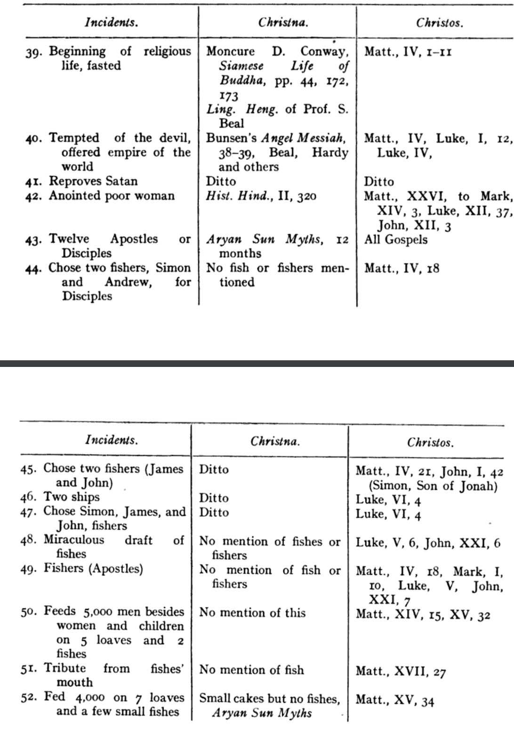
Christna and Christos
Virgin Birth
Godly biological father
Earthly foster dad
Deity in flesh
1/3rd of trinity
Angels hail birth
Star Birth Announcement
Pleasing sounds from sky
Shephards attend birth
Expensive gifts
Born poor
Paying taxes
Preceded by another
Ruler tried to kill forerunner
Well-learned when young
Cured leprosy
Offered world by devil
Anointed by poor woman
Performed catering miracle
Walked upon the water
Predicts his own death
Pierced by metal
Died and rose again
Promise to return on white horse

Slide 14
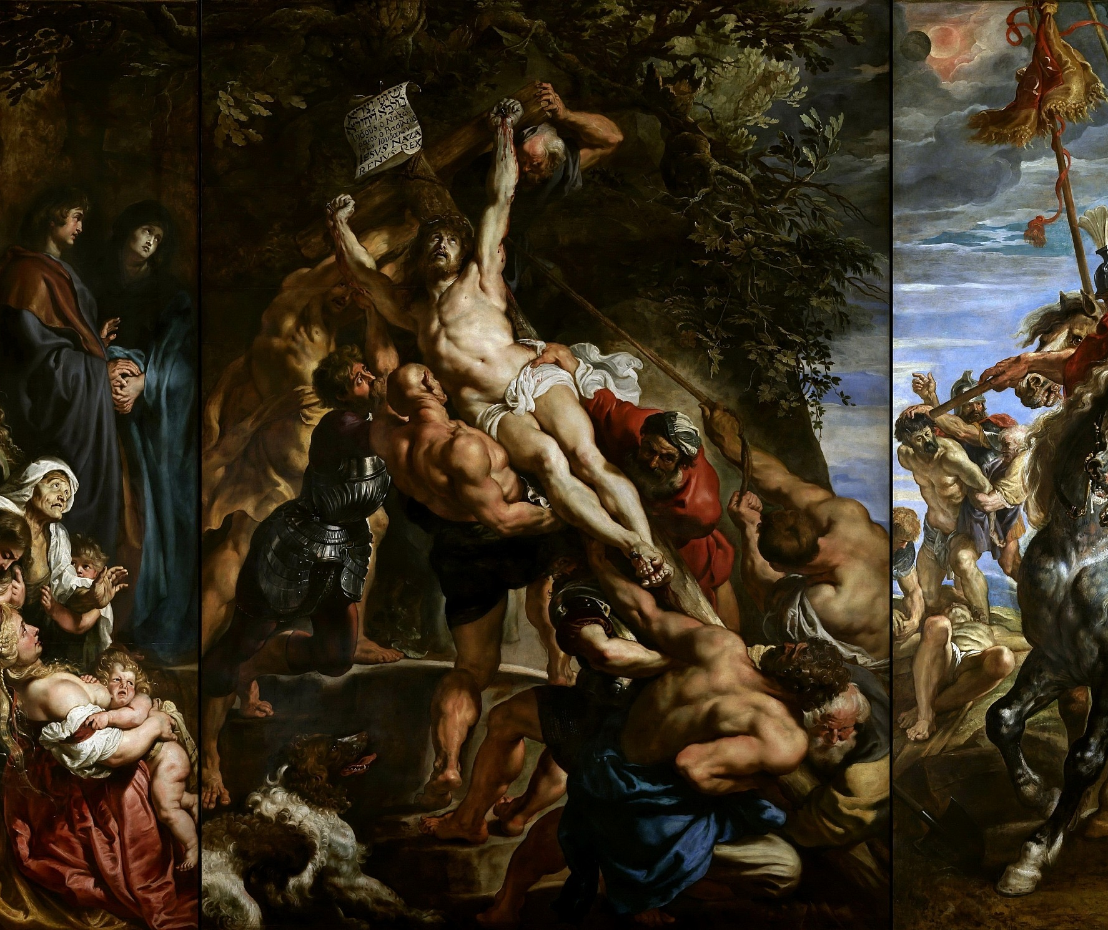
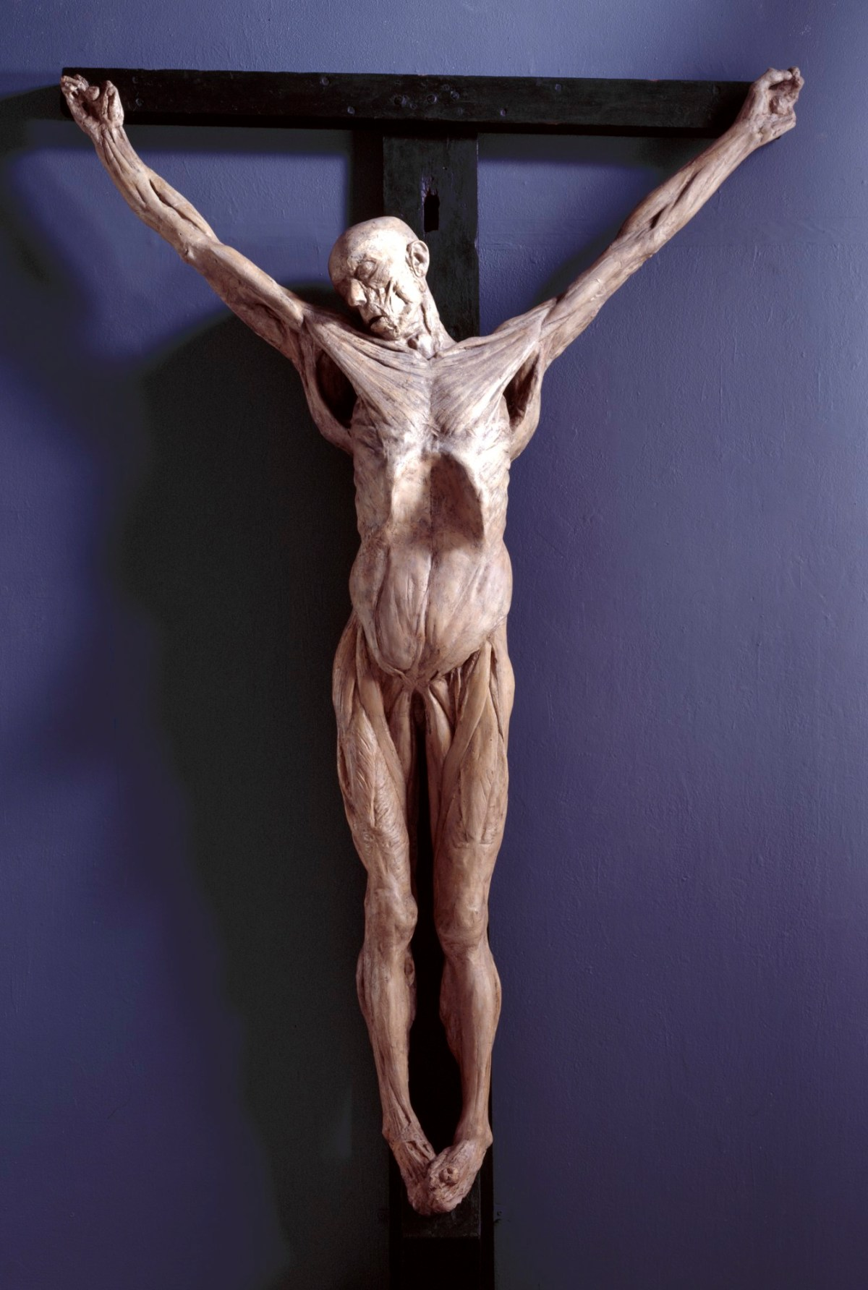
Messiah-like "saviors" crucified before ascending into heaven.
Thulis of Egypt, 1700 BC
Krishna of India, 1200 BC
Crite of Chaldea, 1200 BC
Atys of Phrygia, 1170 BC
Tammuz of Syria, 1160 BC
Hesus or Eros 834 BC
Bali of Orissa, 725 BC
Indra of Tibet, 725 BC
Iao of Nepal, 622 BC
Buddha Sakia, 600 BC
Mithra, 600 BC
Alcestos, 600 BC
Quezalcoatl, 587 BC
Wittoba, 552 BC
Prometheus, 547 BC
Quirinus of Rome, 506 BC

Slide 15
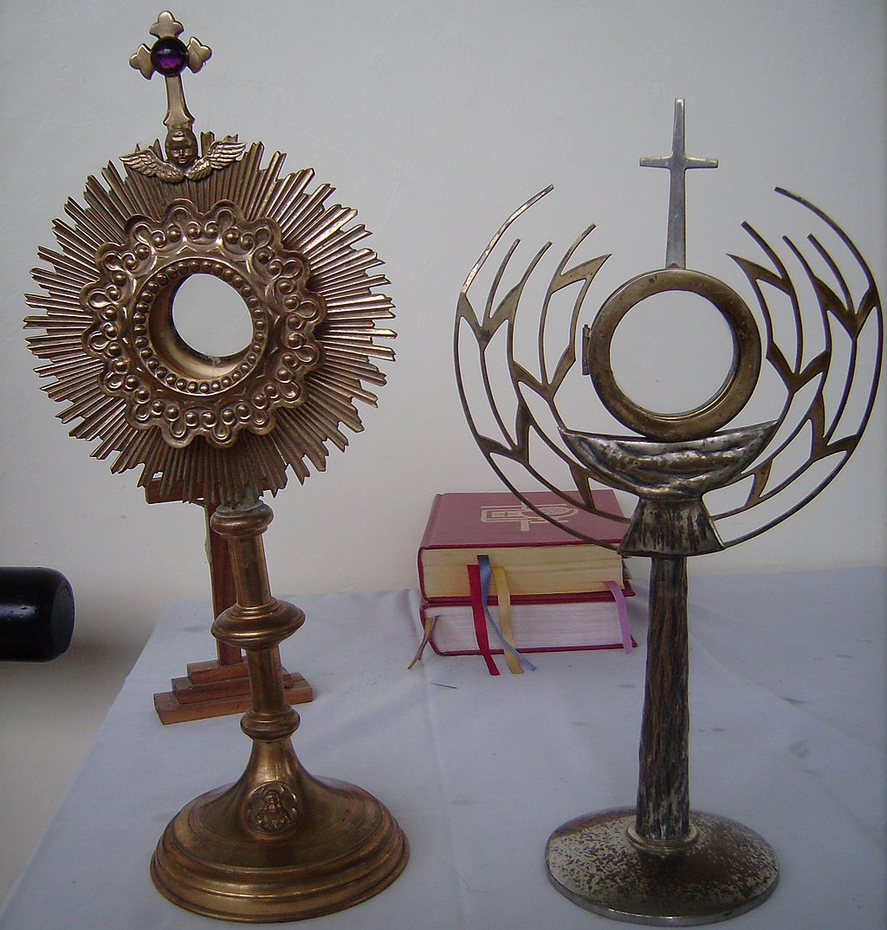
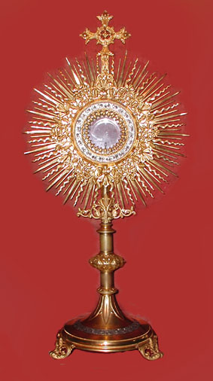
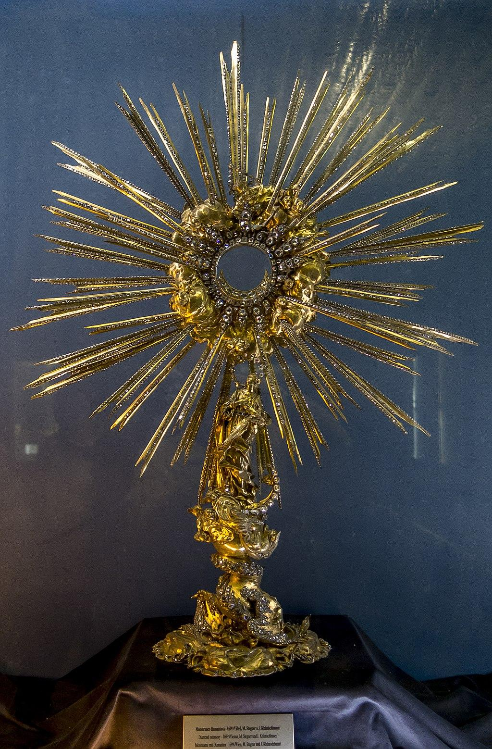
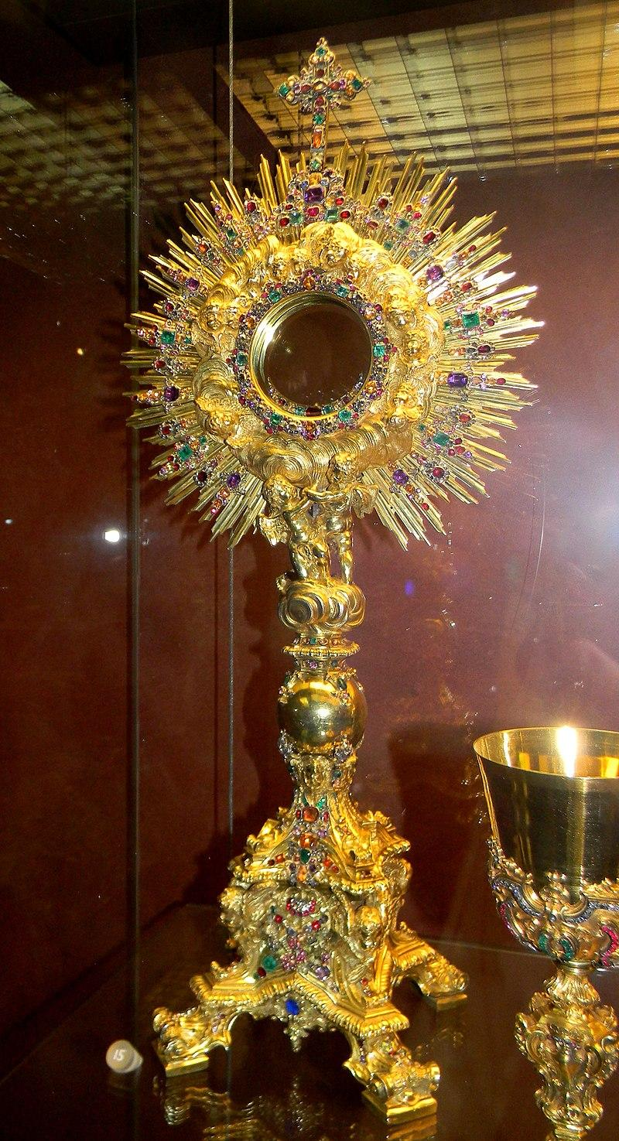
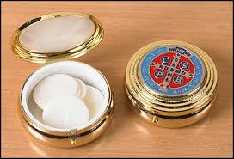
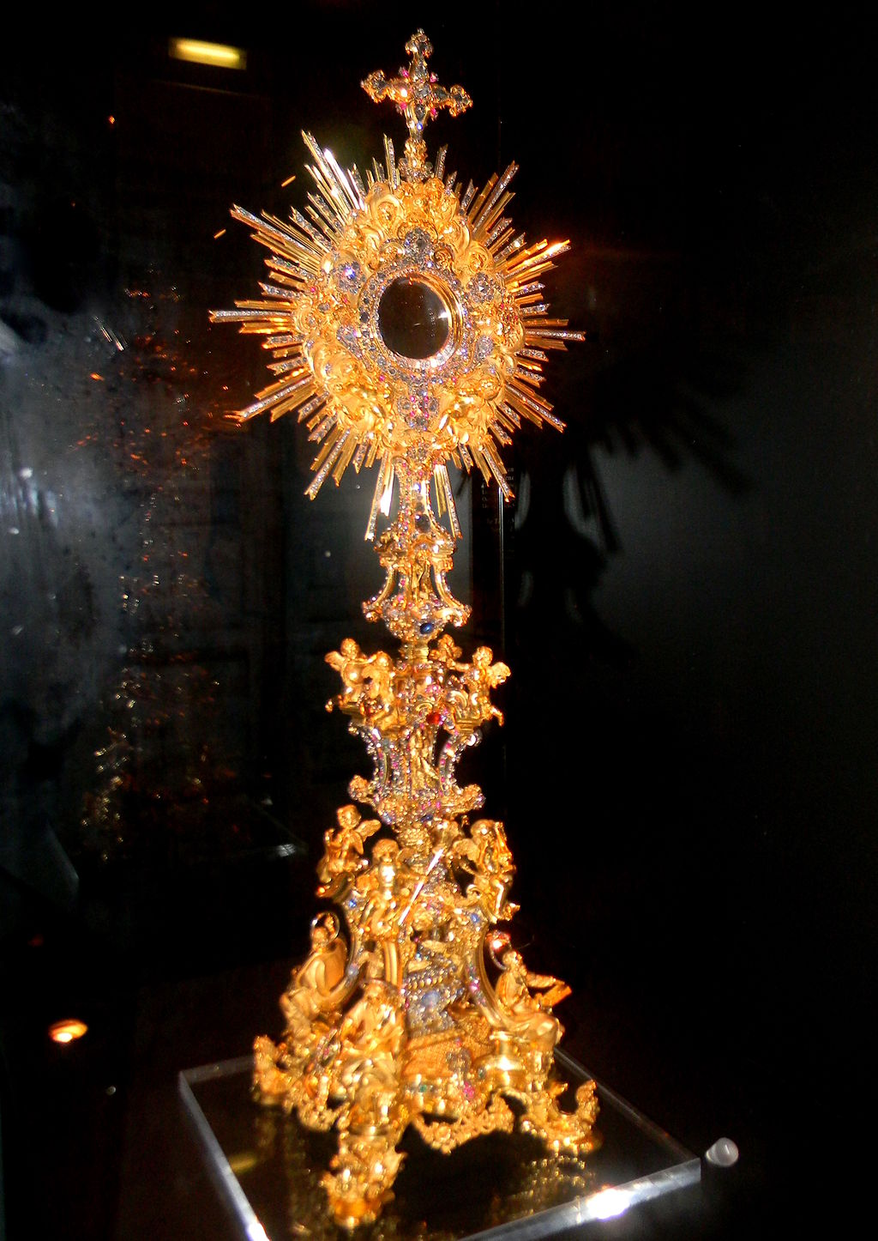
The punishment of death was meted out also to anyone touching, looking into or inquiring as to our monstrance and pyx — the monstrance being an “almond” -shaped or dove - shaped vessel representing woman, or the membrum femininum, and the pyx a rod - like article which lay inside the monstrance (or mother), and death was meted out to one of our soldiers by his being hanged, drawn and quartered in sight of the French enemy (for having touched the monstrance and pyx) before the battle of Agincourt.
Monstrance
Pyx

Slide 16
How did we get from ‘4000 phalluses found in a roman orgy pit’
to
‘The Lord is my Shepherd I shall not want?’

Slide 18
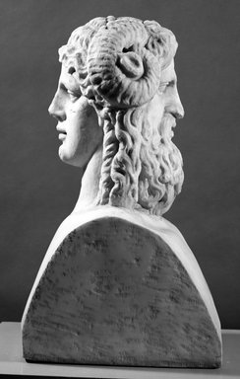
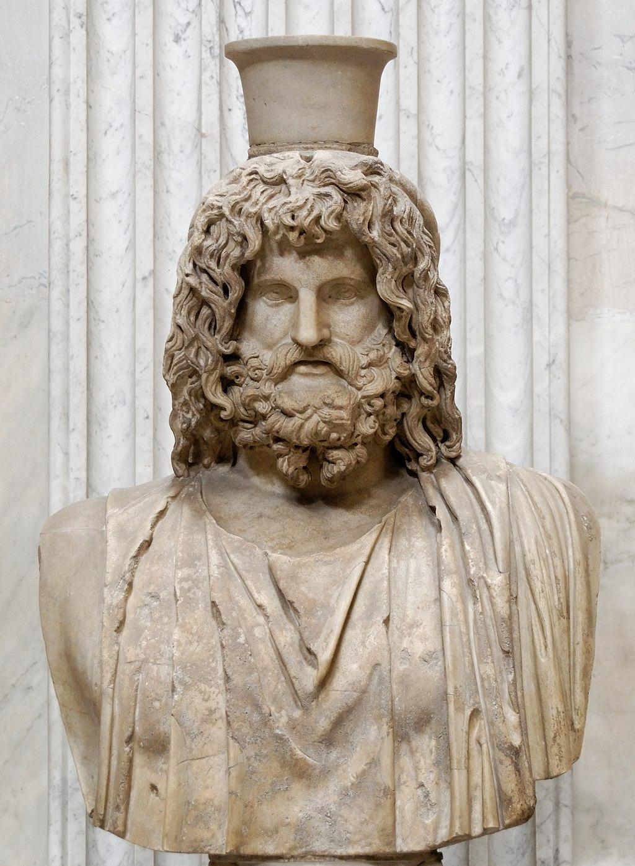
The Egyptian Christ

Slide 20
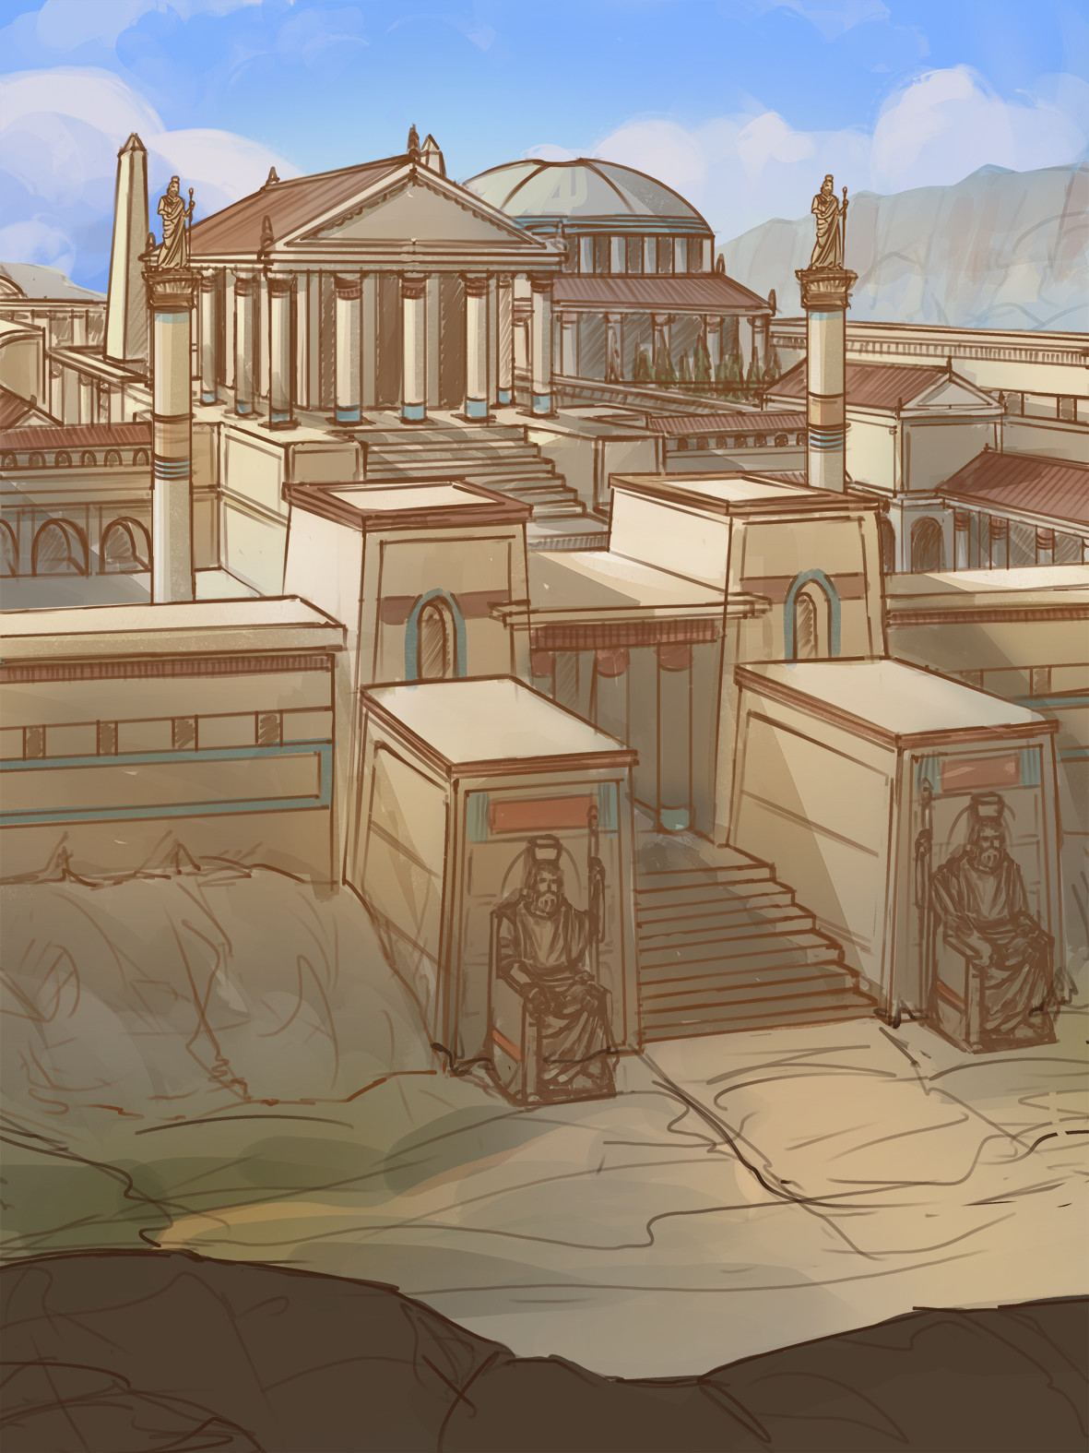
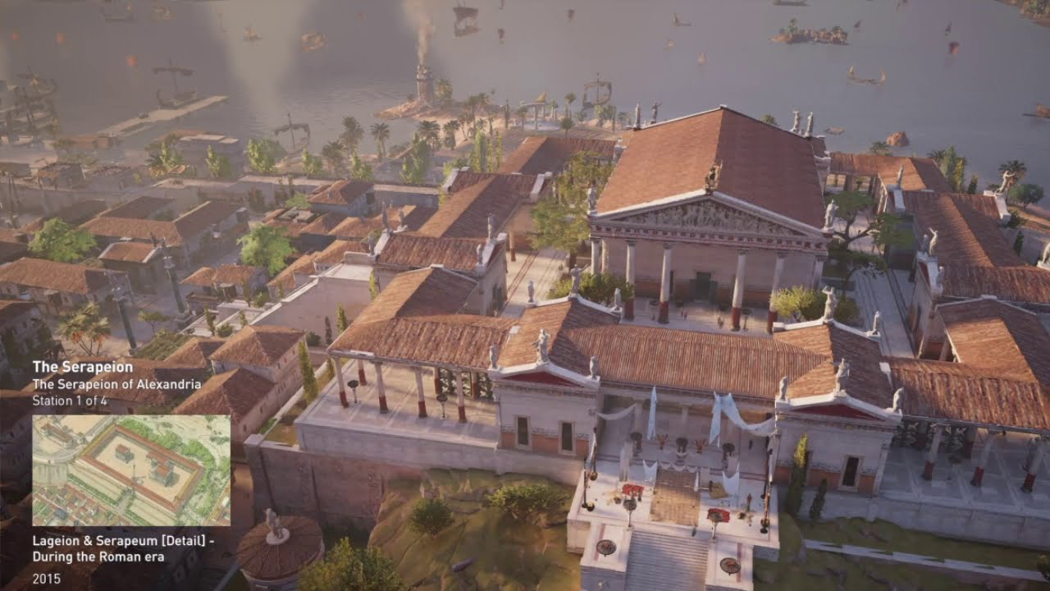
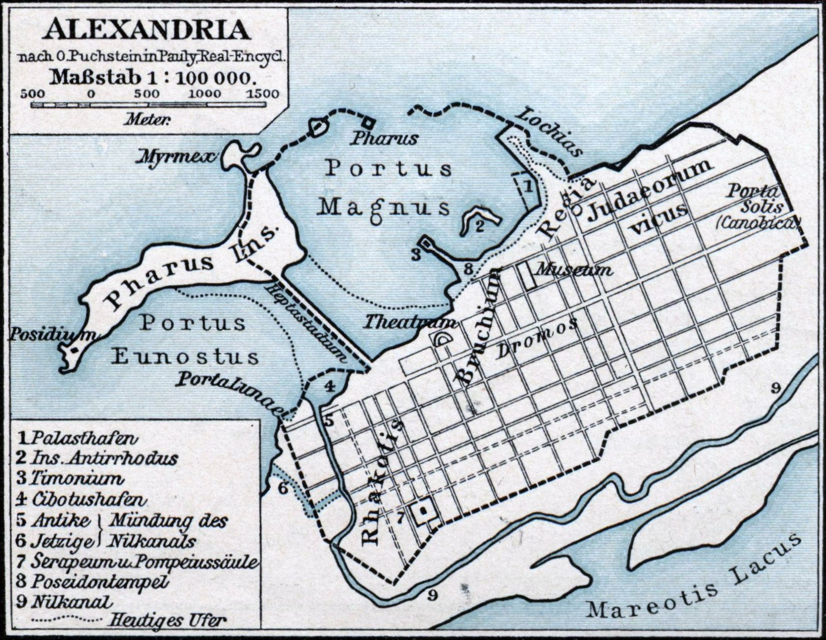
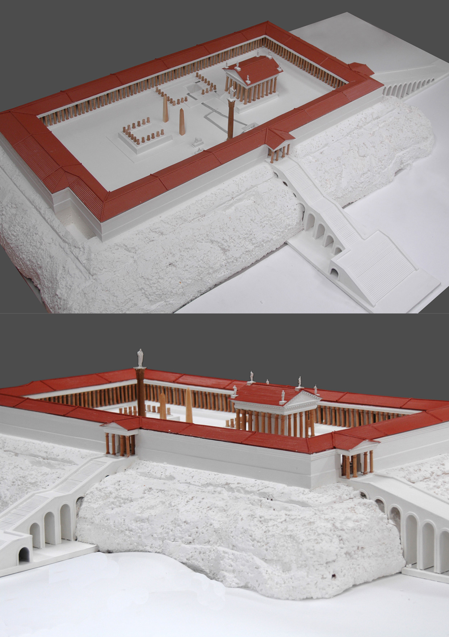
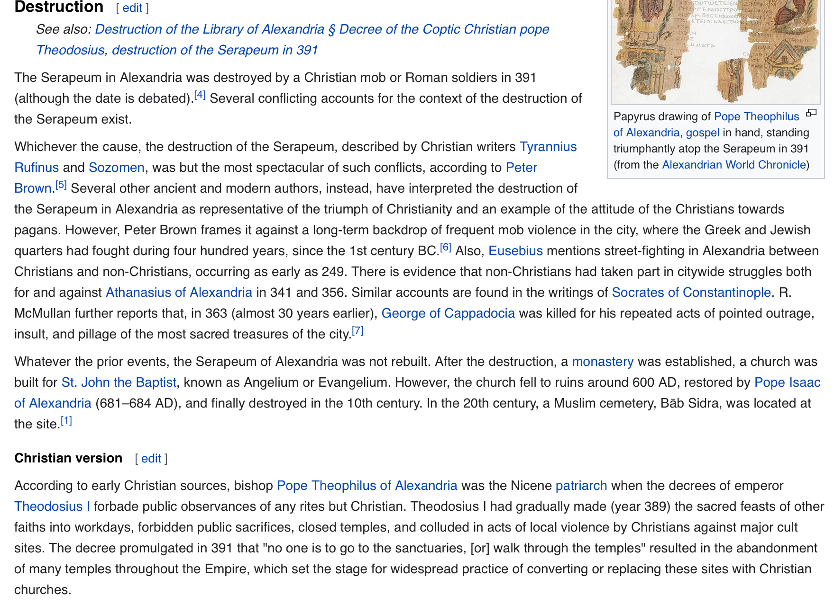
Christian Mob destroys Pagan Library

Slide 21
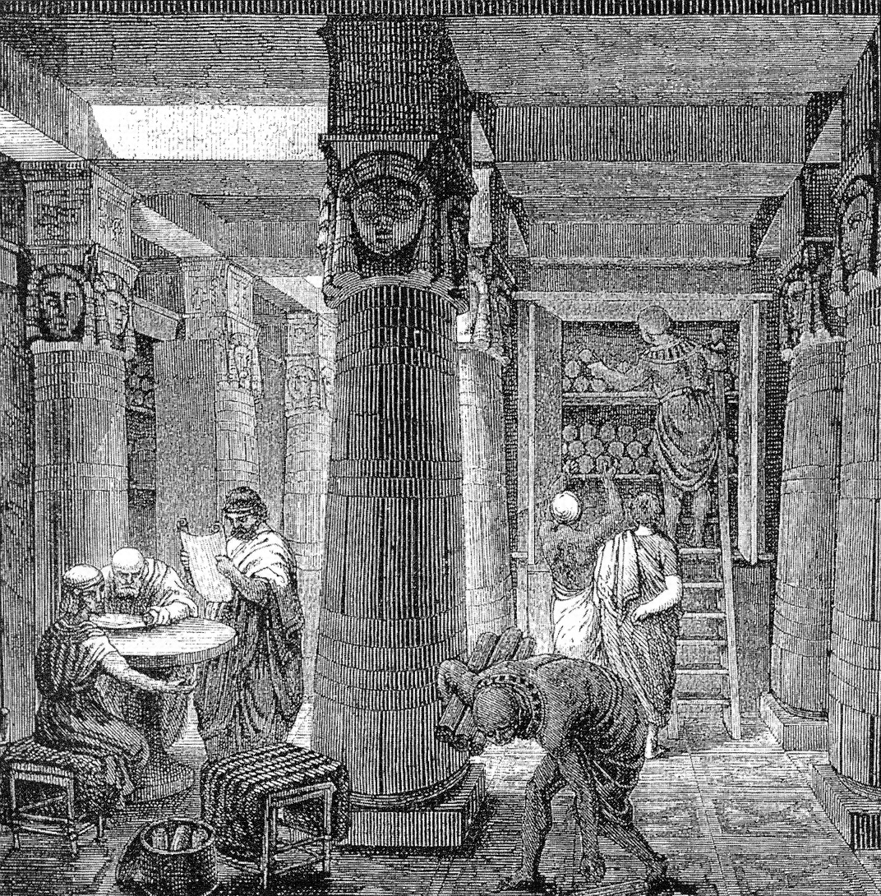
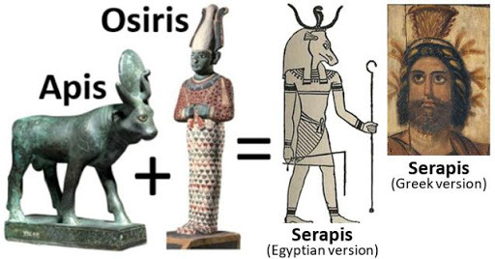
The First Internet
The Library of Alexandria was spammed with curated Roman scripture.
Serapis (Apis and Osiris) had to rewritten.
Scriptural Exodus

Slide 22
Jesus was born in a manger due to a tax issue.
Odds are things like Romans 13 weren’t his teachings.

Slide 23
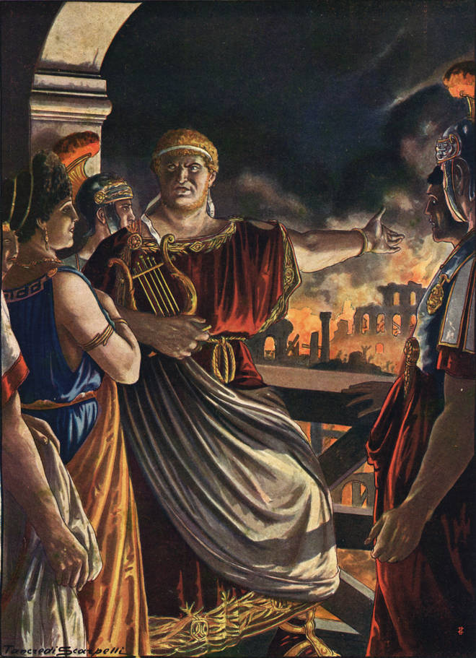
Why is it so hard to believe Rome was a controlled demolition?

Slide 24
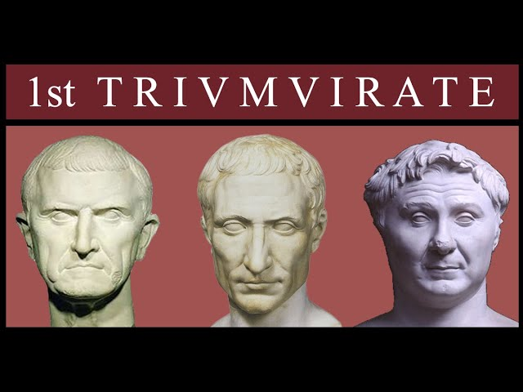
Why is it so hard to believe
the First Triumvirate wasn’t the last?

Slide 25
People will believe the year is 1 AD if you apply enough marketing.

